Slide 1
Intro to Natural Language Processing Project Delivery #2 - Machine Learning based Text Classification
150119724
Hasan Hut 150119764
Mustafa Furkan Yapıcıoğlu 150119724
Murat Fidan 150119901
Hüseyin Hasılcı 150119698

Slide 2
Steps
Data pre-processing
Classifier Models
Evaluation

Slide 3
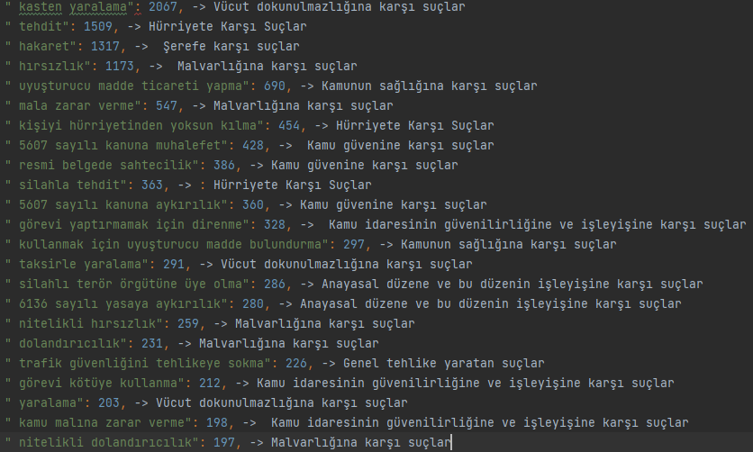
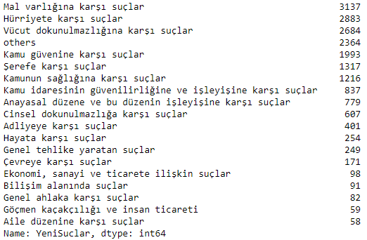
Data pre-processing

Slide 4
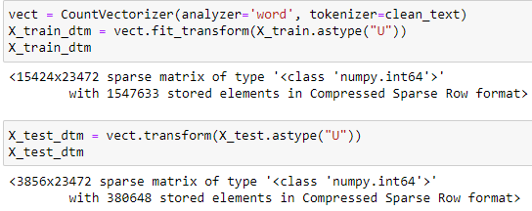
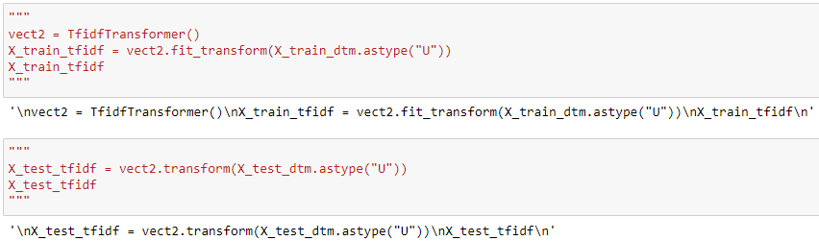
Data pre-processing(cont’s)

Slide 5
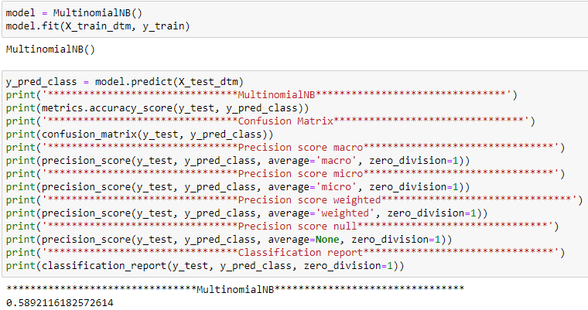
Classifier Models – Multinomial Naive Bayes

Slide 6
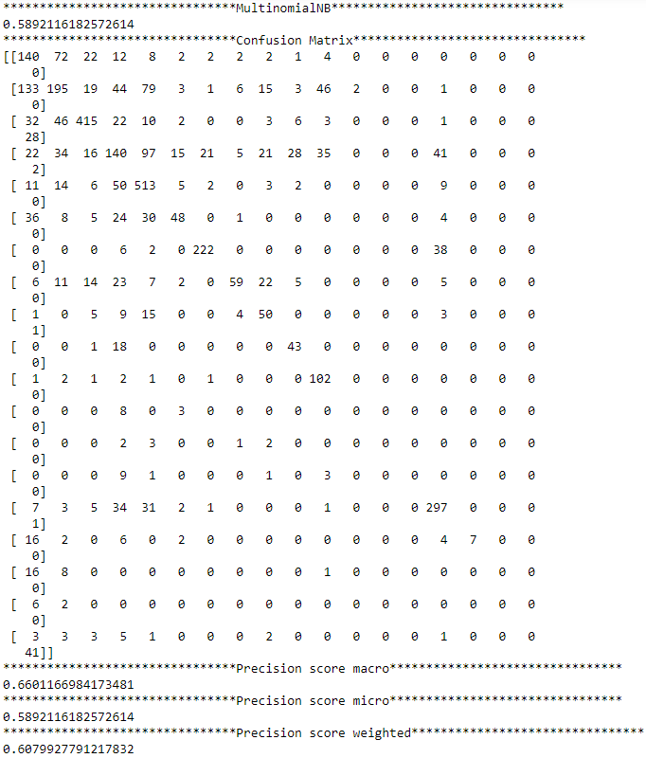
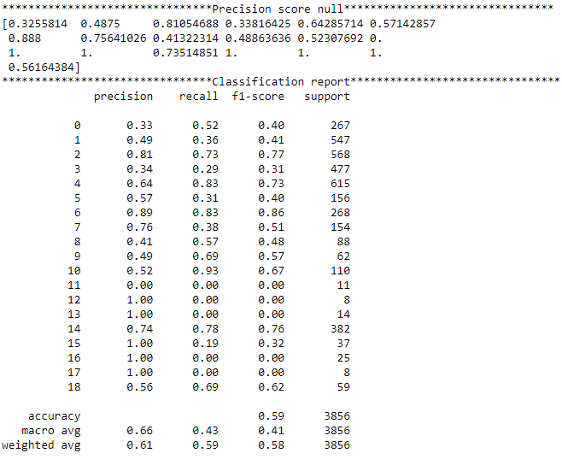
Classifier Models With Evaluation – Multinomial Naive Bayes

Slide 7
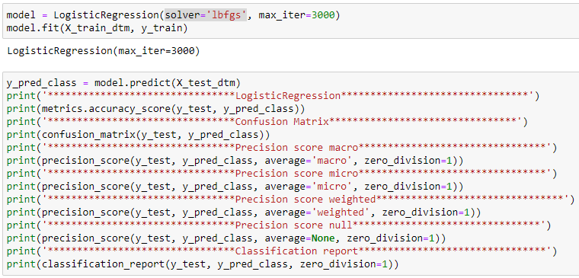
Classifier Models – Multinomial Logistic Regression

Slide 8
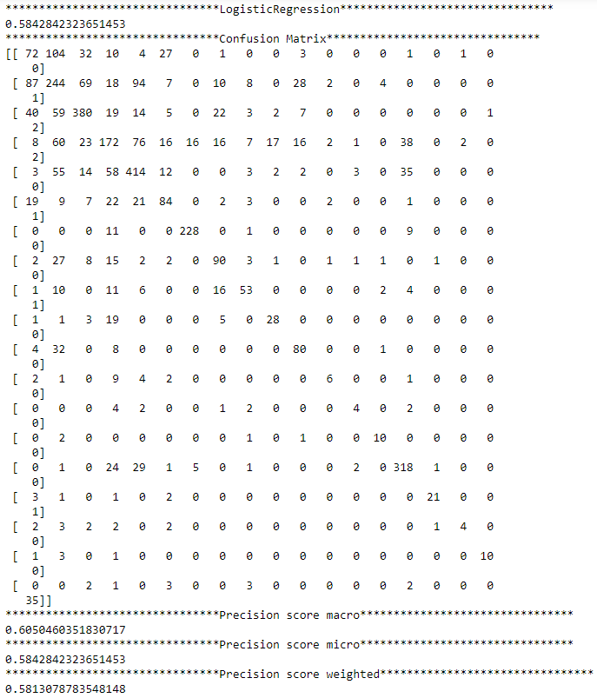
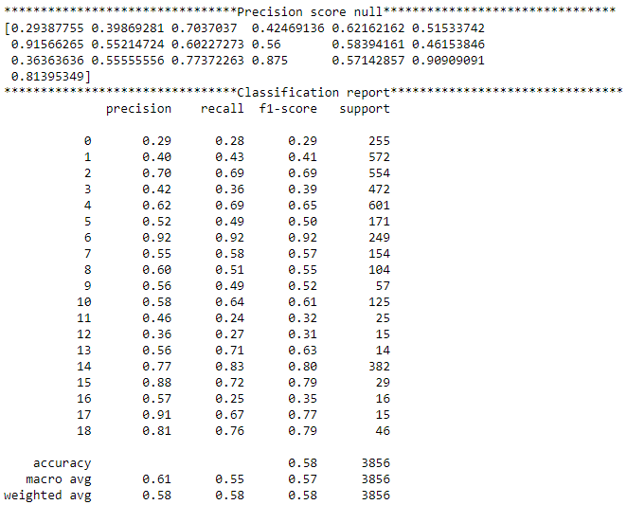
Classifier Models With Evaluation– Multinomial Logistic Regression

Slide 9
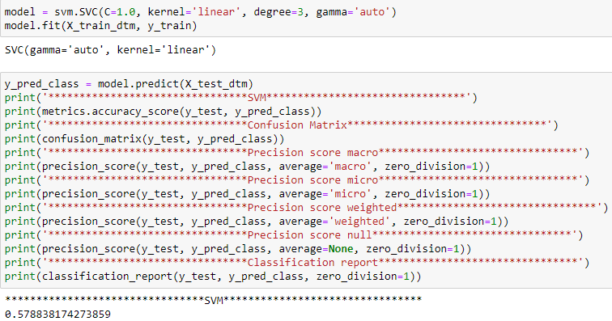
Classifier Models– SVM

Slide 10
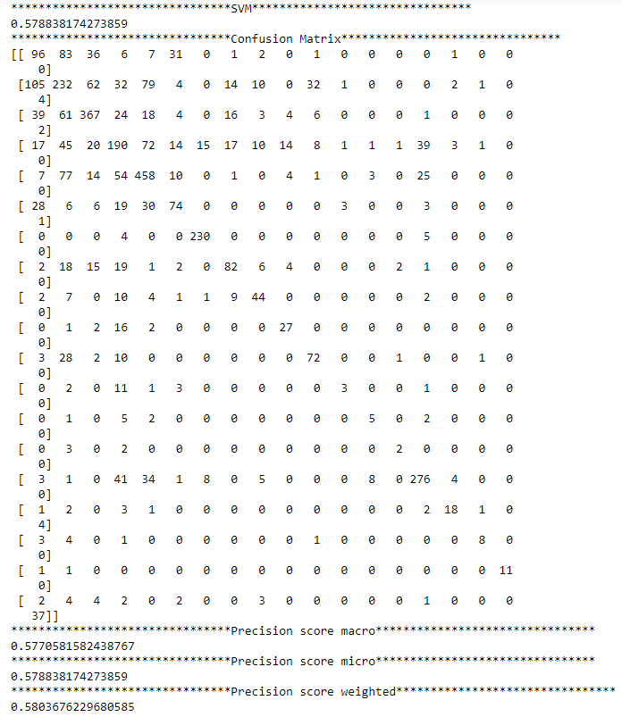
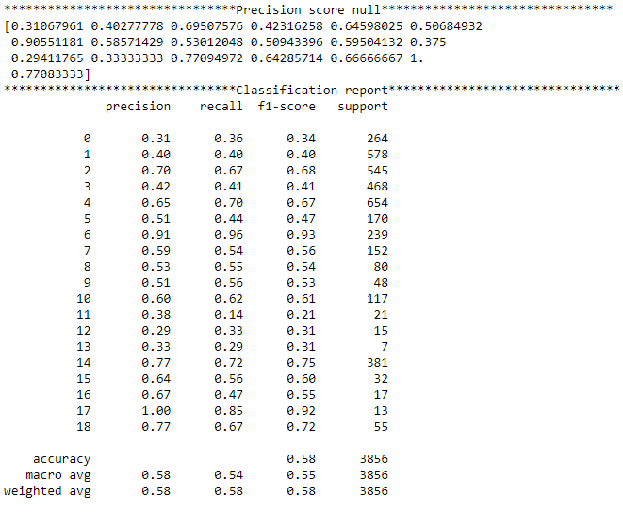
Classifier Models With Evaluation– SVM

Slide 11
THANK YOU FOR LISTENING

